Slide 1
Hack-at-Luddy Team SASS
Tweet Classification
Contents
Aim
Data Visualization
Data Preprocessing
Training Data and Model Description
Results and Output
Github link - https://github.com/saurgul/hack-at-luddy-SASS

Slide 2
Aim
Build a model that can predict antisemitic/ non-antisemitic tweets with the gold standard data (~3200 tweets) as input
Visualize differences between antisemitic and non-antisemitic tweets
Use the above train model to predict whether test tweets (~800 tweets) are antisemitic / non-antisemitic tweets

Slide 3
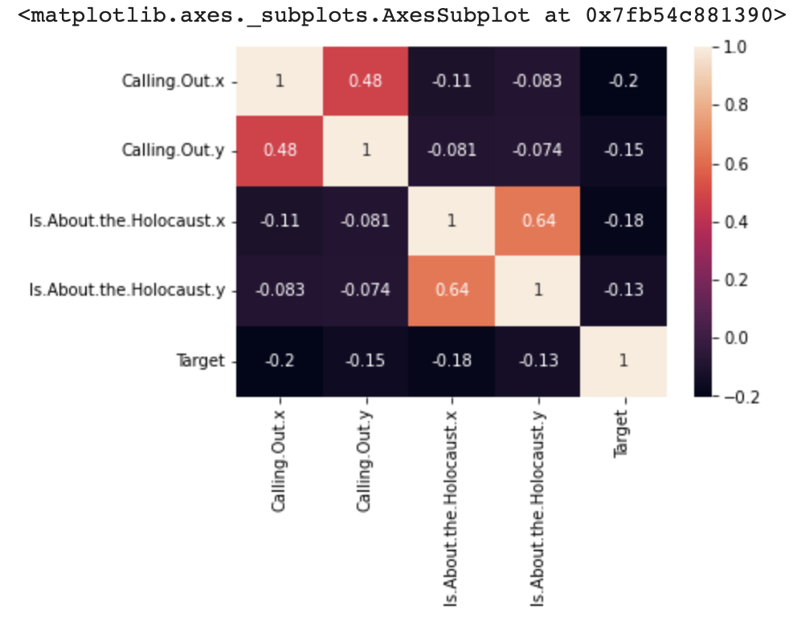
Data Visualization
As seen in the below heat map the correlation of the given variables was very low with the target variable, we decided to drop them while training the model.
It is also observed that all the attributes are negatively correlated with the target.

Slide 4
Data Preprocessing
Initially, before training the data, the emojis & special characters were removed from the tweets
The tokenization of the train data and test data is performed to identify the stop words using ‘nltk’ package
The tweets are processed in a way that only relevant words are taken for the classification & training of model
This preprocessed dataset, is splitted into training & validation sets, which are further used to train & validate the model (80% training, 16% validation and 4% test data)

Slide 5
Training Data and Model Description
For the tweet classification problem, as there was a negative correlation between the target and other columns (such as sentiment, is about the holocaust) in the data, hence, we decided to use the tweet text as our input itself
The model that we have used is the Bidirectional Encoder Representations from Transformers.
As opposed to directional models, which read the text input sequentially (left-to-right or right-to-left), the Transformer encoder reads the entire sequence of words at once.
Therefore it is considered bidirectional, though it would be more accurate to say that it’s non-directional. This characteristic allows the model to learn the context of a word based on all of its surroundings (left and right of the word).
Using the model and the training data from the gold standard tweets, we were able to achieve good results

Slide 6
Results and Output - BERT Model
A confusion matrix is a summary of prediction results on a classification problem. When generated a confusion matrix for training dataset the results as below
The final accuracy is 84.4% on the test data
 | Positive | Negative
Positive | 70.5% | 6.2%
Negative | 9.3% | 13.9%
Class | Precision | Recall
0 | 88% | 92%
1 | 69% | 60%

